Slide 1
NFL PredX 2022
Salim Jivani, Ali Tahririan, Aniv Chakravarty, Satish Bitra

Slide 2
Project Description
The National Football League (NFL) is the most popular sports league in the United States.
The motivation for this project is the interest in watching football and linking sports statistics to the results. The practice of using Machine learning model and sports analytics mainly based on the same mathematics – statistics. After going through various sports predicting websites the curiosity increased to create a similar model that can be built up with other features such as player-specific data.
The goal is to combine different features to determine what defines a victory. Data is included from 2014 to 2021.

Slide 3
Objectives
First we would like to run the data as is through various logistic regression models. Get the accuracy levels
Then we would like to combine, filter, augment, standardise the features and run them through the models. Get the accuracy levels.
From then we would like to determine the next best path. Maybe a combination of changing features and model architecture. Try a bunch of combinations to determine the best model.

Slide 4
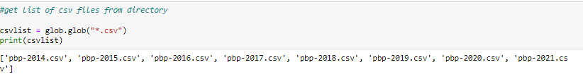
Dataset
We have got data from 2014-2021 on NFL games played, play-by-play. Each year is comprised of its own CSV file.

Slide 5
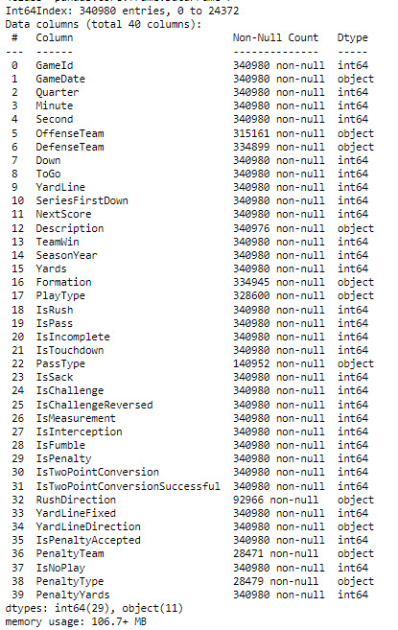
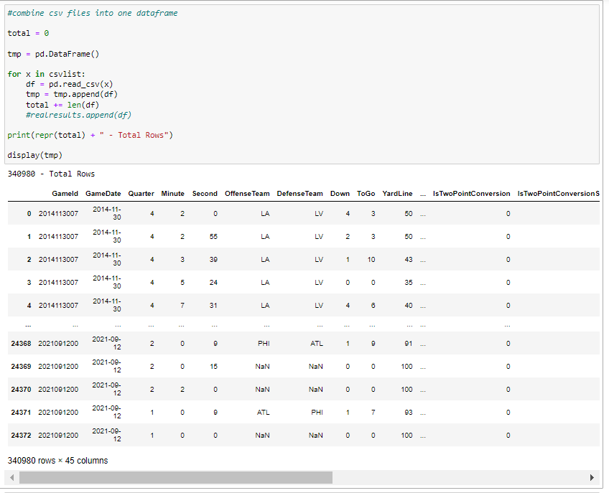
Dataset Cont.

Slide 6
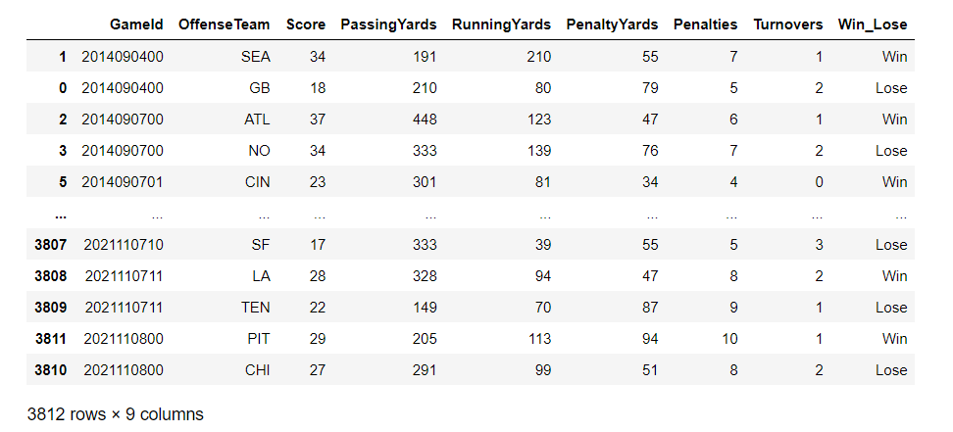
Dataset Cont.

Slide 7
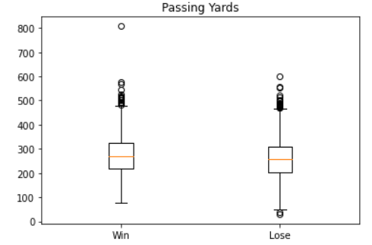
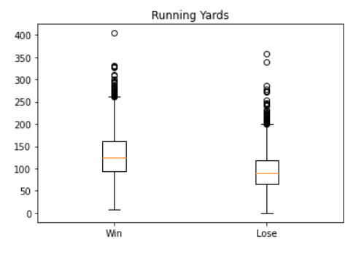
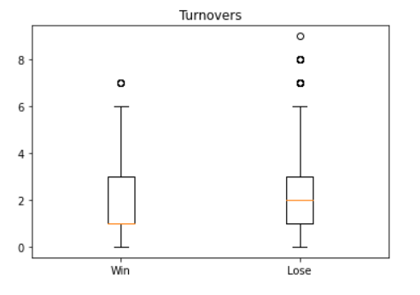
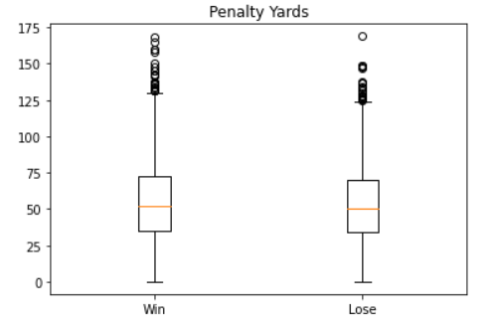
Preliminary Analysis and Results

Slide 8
Models
Linear Regression
Logistic Regression
SVM

Slide 9
Models
KNN
Random Forest

Slide 10
Models
Naive Bayes
Decision Tree

Slide 11
Work to do
Analysis of models on data
Feature analysis
New feature combination and techniques
Results and analysis

